Slide 1
Raspberry Pi
Day 4

Slide 2
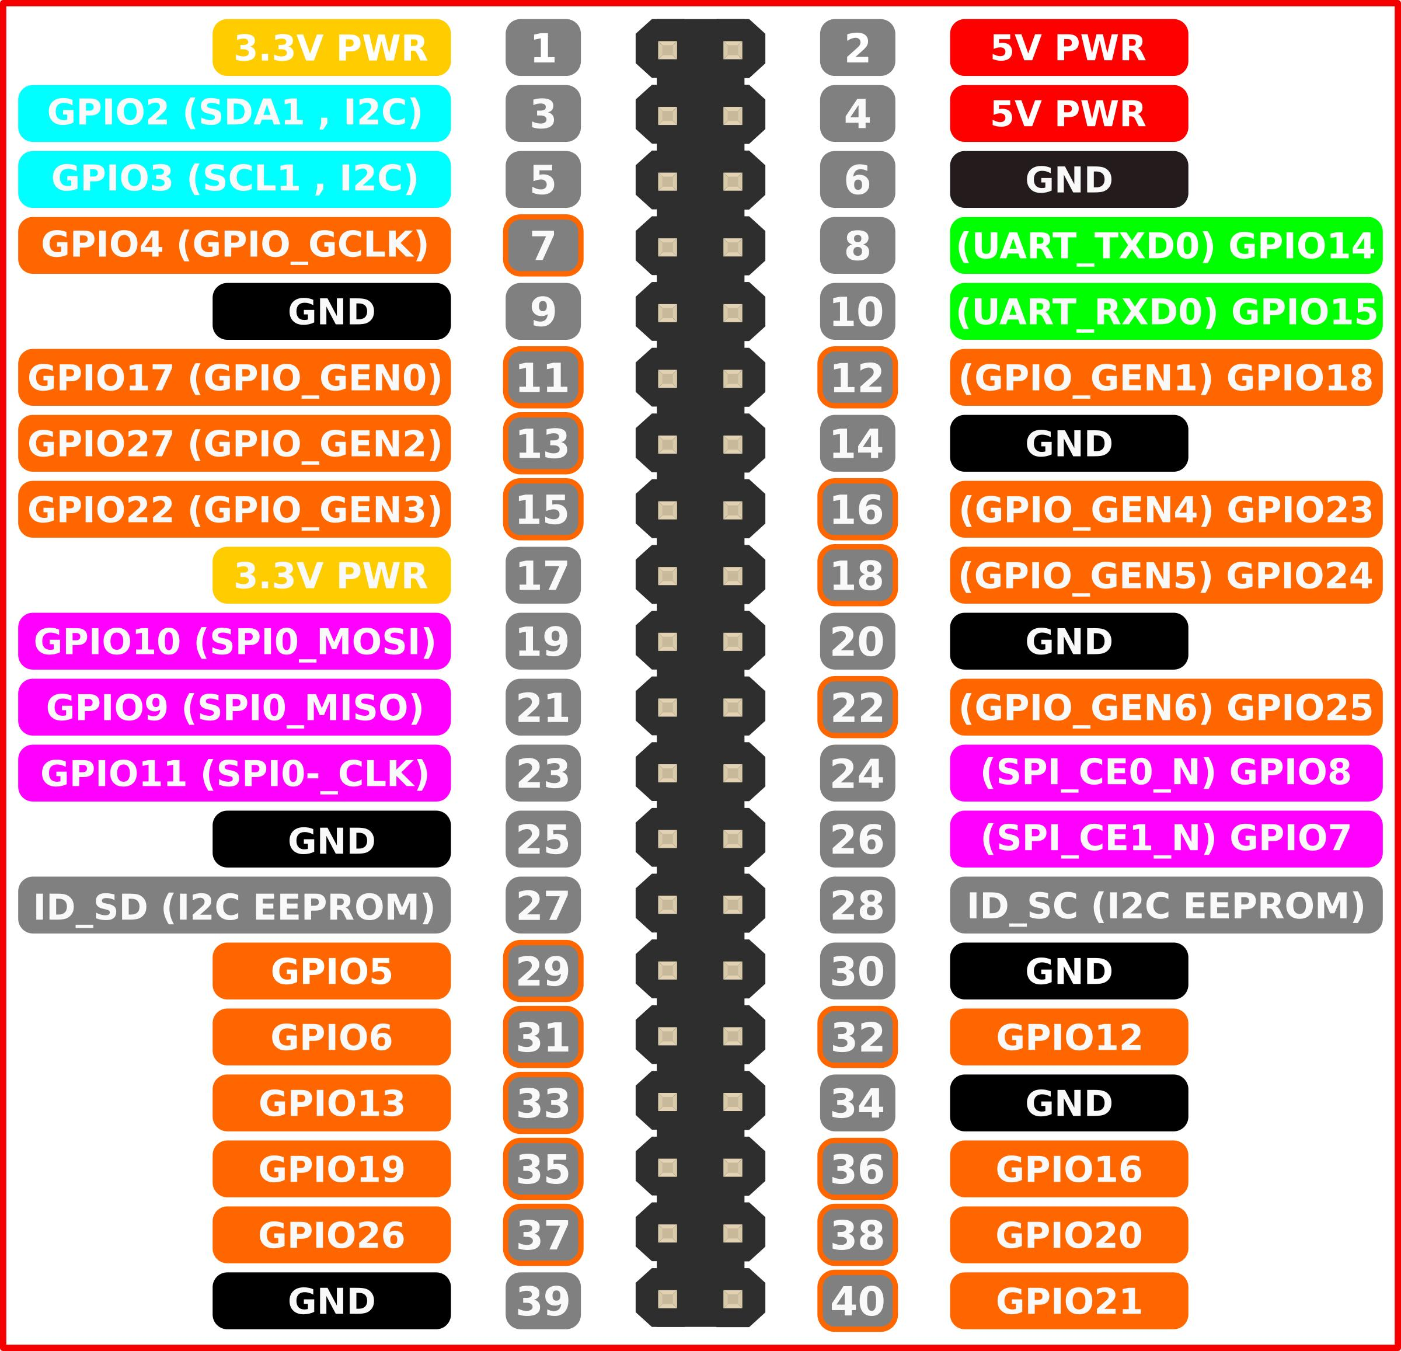
GPIO PINOUT

Slide 3
Raspberry Pi: Char LCD (example code)
$ git clone https://github.com/adafruit/Adafruit_Python_CharLCD.git
$ sudo apt-get install build-essential python-dev python-smbus python-pip
$ cd ~/Adafruit_Python_CharLCD/
$ sudo python setup.py install
$ cd ~/Adafruit_Python_CharLCD/examples
$ sudo nano char_lcd.py #assign the pin according to your hardware
$ python char_lcd.py

Slide 4
Python: JHD162 Digital Clock
import time
import datetime
import Adafruit_CharLCD as LCD
lcd_rs = 21
lcd_en = 20
lcd_d4 = 26
lcd_d5 = 19
lcd_d6 = 13
lcd_d7 = 6
lcd_backlight = 5
lcd_columns = 16
lcd_rows = 2
lcd = LCD.Adafruit_CharLCD(lcd_rs, lcd_en, lcd_d4, lcd_d5, lcd_d6, lcd_d7,
lcd_columns, lcd_rows, lcd_backlight)

Slide 5
Python: JHD162 Digital Clock (cont.)
lcd.message('Hello\nWorld')
time.sleep(5)
lcd.clear()
while True:
lcd.clear()
cur_time = datetime.datetime.now().strftime('%Y-%m-%d %H:%M')
print(cur_time)
lcd.message('Current Time\n'+cur_time)
time.sleep(0.5)
cur_time = datetime.datetime.now().strftime('%Y-%m-%d %H %M')
lcd.message('Current Time\n'+cur_time)
time.sleep(0.5)

Slide 6
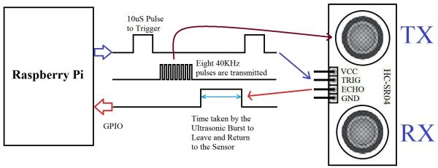
Ultrasonic distance sensor : distance measurement
GPIO 26
GPIO 19

Slide 7
PING sensor: distance measurement (cont).
import RPi.GPIO as gpio
import time
TRIG = 26
ECO = 19
gpio.setwarnings(False)
gpio.cleanup()
gpio.setmode(gpio.BCM)
gpio.setup(TRIG, gpio.OUT)
gpio.setup(ECO, gpio.IN)
gpio.output(TRIG, True)
time.sleep(0.0001)
gpio.output(TRIG, False)
while gpio.input(ECO) == False:
start = time.time()
while gpio.input(ECO) == True:
end = time.time()
pulse_dur = end-start
#cm:
distance = pulse_dur / 0.000058
print('Distance measured: {} cm'.format(distance))
#inches
distance = pulse_dur / 0.000148
print('Distance measured: {} inches'.format(distance))
gpio.cleanup()

Slide 8
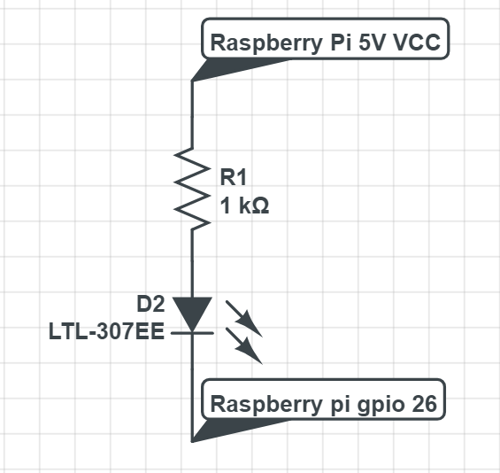
PING sensor: distance measurement
13

Slide 9
Distance Sensor: Near distance warning led
import RPi.GPIO as gpio
import time
gpio.setwarning(False)
gpio.cleanup()
trig = 26
eco = 19
gpio.setmode(gpio.BCM)
gpio.setup(TRIG, gpio.OUT)
gpio.setup(ECO, gpio.IN)
def get_distance():
gpio.output(trig, True)
time.sleep(0.0001)
gpio.output(trig, False)
while gpio.input(eco) == False:
start = time.time()
while gpio.input(eco) == True:
end = time.time()
dif_time = end – start
distance = dif_time / 0.000148
return distance
led = 13
gpio.setup(LED, gpio.OUT)
def warning_led(_val):
if _val == True:
gpio.output(led, True)
else:
gpio.output(led, False)
while True:
dist = get_distance()
print(‘Distance {} cm’.format(dist))
if distance < 10:
warning_led(True)
else:
warning_led(False)
time.sleep(0.5)

Slide 10
Interfacing DHT sensor
DHT sensor: Digital Humidity and Temperature
$ sudo apt-get install build-essential python-dev
# getting library support from Adafruit support
$ git clone https://github.com/adafruit/Adafruit_Python_DHT.git
#installing DHT library into the system
$ cd Adafruit_Python_DHT
$ sudo python setup.py install

Slide 11
Interfacing DHT sensor (cont.)
$ cd
$ cd student_name # if error create dir on your name
$ mkdir dht11
$ cd dht11
$ sudo nano dht11.py import sys
import Adafruit_DHT
while True:
hum, temp = Adafruit_DHT.read_retry(11, 4)
print ('Temp: {0:0.1f} C Humidity: {1:0.1f} %'.format(temp, hum)

Slide 12

END of Part - 4 (Sensor Interfacing)

